Slide 1
IMPROVEMENT RESULT REPORT
May.2022
Department : Information System
Presenter : Nguyen Nhu Minh
Total topics : 5 Topics
Save cost : 7.8K$/Year
Save time : 1,046h/Year
Notes:
Good morning every one!
My name is Minh ,member of IT department.
Today, I’m delighted to be here to tell you about B&A report.
My presentation have to 5 topics
Save cost: 7 point 8 K$
Save time: More than one thousand hour.

Slide 2
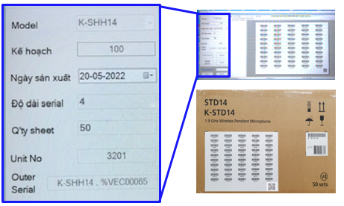


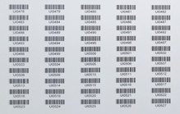
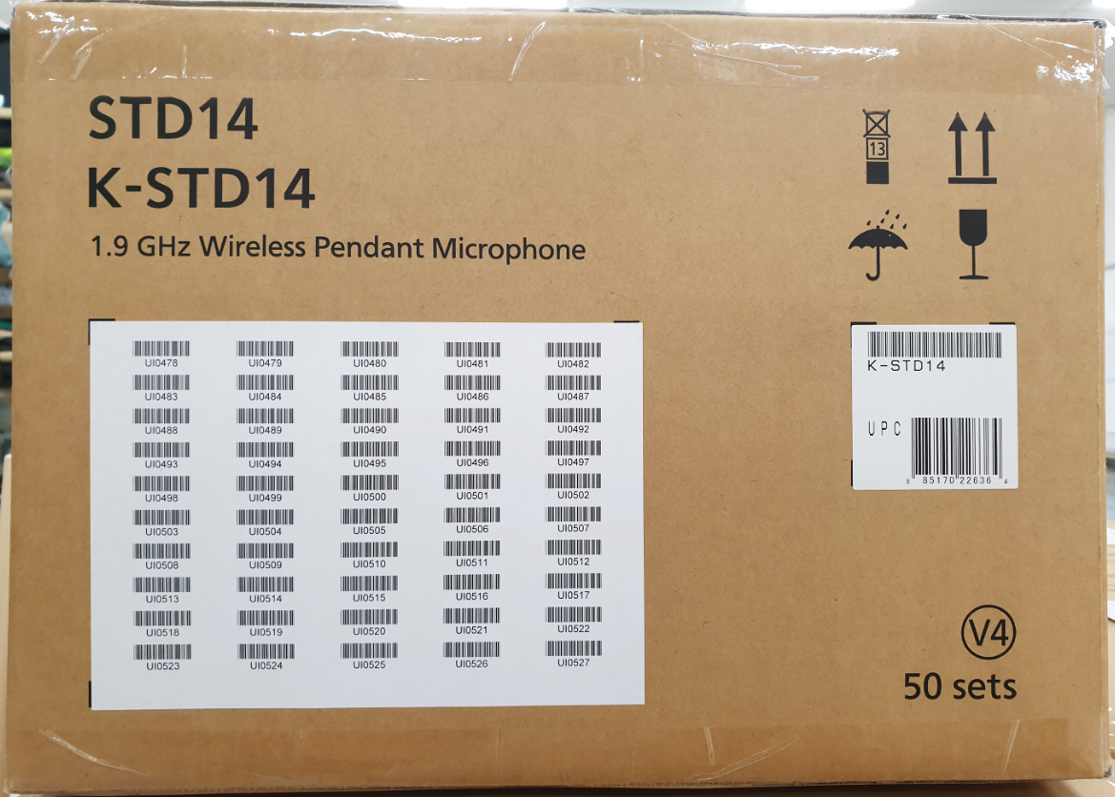
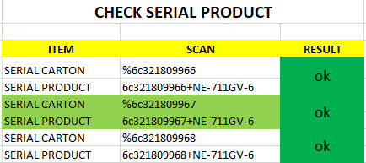


ADD MORE QR CODE LABEL FOR SHIPMENT STATION
1/5
Reduce time and operation for FA, SCM department by add QR label outer carton.
Developer: Develop team
Apply: Jan.2022
Expn: 0
Save time: 7,8K$ /Y
◆Before
◆ After
New soft printing label
Data file
Printing
Check sheet
New functions: Confirm all serial product by scan QR code only
In line production: Weight check process will scan one by one serial & link to QR code
In Shipment Station : Confirm Serial No.
One by one scan serial (Loss time)
Weight check not control quantity serial inner on carton box
Choose Model
➔ Auto Get serial number continue
Shipment
Shrink pallet ID
Weight check
Currently :
Manual data excel to print bar-code serial -> Easy mistake, not control serial inner.
Weight check not detect when scan wrong serial inner of another one carton. (Affect to quality )
Shrink system: Confirm serial one by one → lost time (250s/box)
When shipment station: Confirm serial one by one → lost time (250s/box)
Plan : 28,800 box/ Year Loss : 2K hour ~ 4K USD (FA&SCM)
Improve :
Printing label automatic generate and control. Easy manage operation and history -> Ensure quality
Weight check auto compare serial inner with serial outer.
Shrink system: confirm by serial No. by scan QR code only (5s/box)
When shipment station: Confirm serial No. by reading QR code only (5s/box)
Plan : 28,800 box/ Year Loss cost: ~ 0.08K USD
SAVE COST: = 7,8K USD/Year
Notes:
First topic, I would like to introduce about: Add QR Code label on Shipment station
Before kaizen:
User need prepare data on excel, Print out, manual compare data actual and checksheet on excel file ( chỉ bút)
This ways, production easy make mistake and lost time
After kaizen:
We make new software: automatic print Checksheet, Add QR Code here.( chỉ bút)
Automatic compare and together use on: Weight check, Pallet ID and Shipment.
With new software, No mistake and reduce cost 7.8K$
2

Slide 3
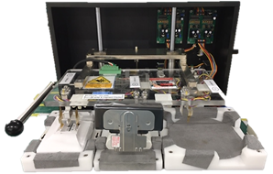
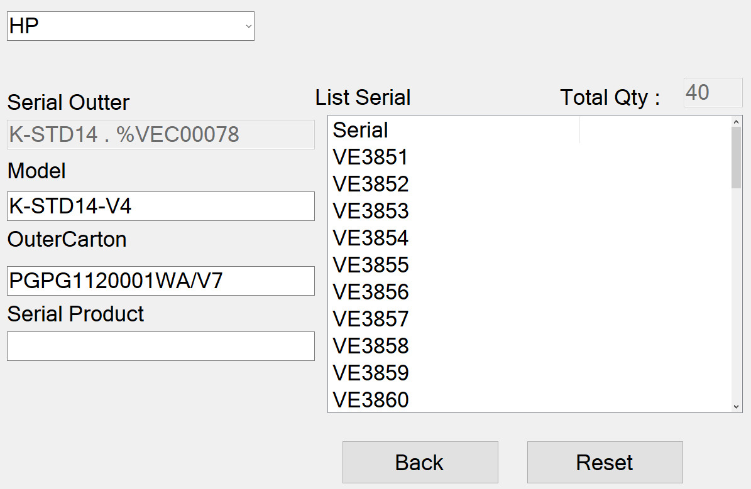




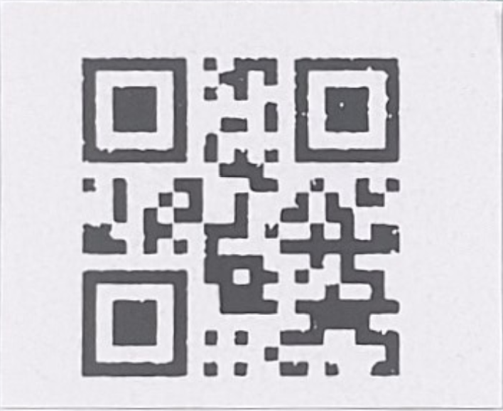
Input serial product into serial outer for sound biz
2/5
Merge serial inner into serial outer carton. Reduce time support for IT department.
Developer: Nguyen Nhu Minh
Apply: Mar.2022
Expn: 0
Save time: 630h/Y
◆Before
◆ After
Weight check
New category
Total outer carton
S/N Link
OK
5kg
Shipping set up
Case NG product (Affect to quality)
Detect error in case NG product Stop line
IT,PE support
Add new function merge serial inner into serial outer on carton box
Currently :
Take long time when NG product -> IT, PE check log file shipment and solve problem.
Take time: 1serial / 5 minutes
~day: 21 serial x 5 = 105 minutes
~3150 minutes/month = 52.5 Hours
~ 630 hours/year.
Improve :
Make new function on Shrink system input serial product into outer.
No stop line and finished carton and continue manufacturing.
User control NG product, after that put them into the serial outer has been setting mater.
Save Time support for IT Total: 630h/Y
Notes:
Next is: Add new function for input Serial number into Serial outer
Weight check will detect if have any error and Line will be stop.
Line leader contact to IT & PE to check data and support.
Kaizen:
User just take out NG product for later check and finished Carton box.
On Shrink system, Adding Serial number into Serial outer.
Save time IT support: 630h per year
--------------------------------------------------------
As you know, The first product goes through the checker machine to check all functions by software. there are many functions to check and is written to csv file to save history. if one of them is NG it not pass.
At the end of product line , weight check stage Detect error in case NG product Stop line.
The user will contact IT and PE member to check data in log file and support until the product is ok, then continue running again at product line.
3

Slide 4
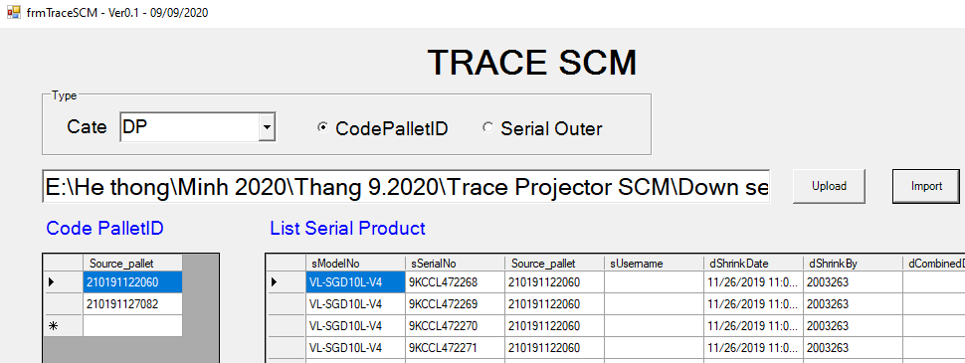


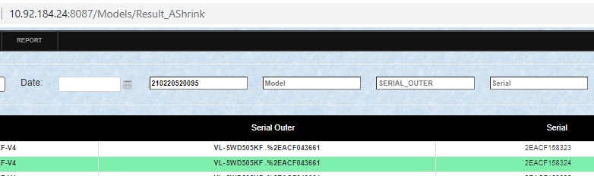
DOWNLOAD SERIAL SYSTEM FOR SCM
3/5
Reduce time for download serial from FOSS system.
Developer: Nguyen Nhu Minh
Apply: Mar.2022
Expn: 0
Save time: 360h/Y
◆Before
◆ After
New system
Mater data
Save data
Data server
Pallet ID
Download serial by only one barcode/ time
Download serial by many barcode at once
Currently :
Download serial by only one barcode/ time.
Take time : 1 minutes/ barcode ~ 45 minutes/shipment
Total take time: ~ 540 hours/Year
Improve :
Make new system can Download all serial by many barcode at once.
Save time: 30 minutes/shipment
=> Save time: 360 hours/Year
Notes:
Next, I introduce about: Download serial number for SCM
For Customer request and traceability, SCM need to download by shipment list
Currently, we only download 1 by 1 shipment
We improve: download list of pallet ID.
Save time: 360 hour per year
4

Slide 5
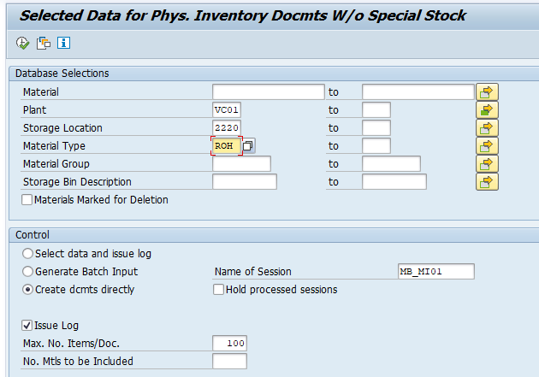
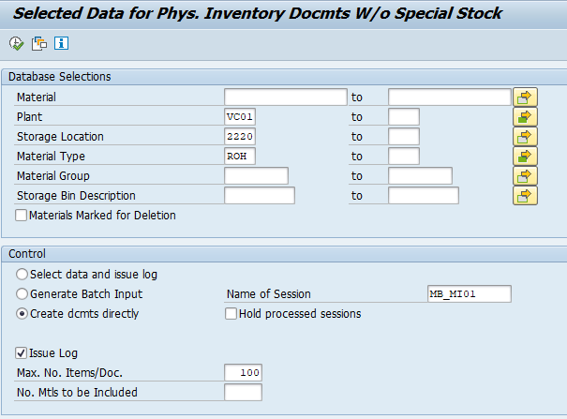
Reduce time to support user inventory
4/5
Reduce time to create physical inventory number for user monthly
Developer: SAP team
Apply: Apr.2022
Expn: 0
Save time: 56h/Y
◆Before
◆ After
~ 900 storage location in SAP
Input each material type each time → 3 type = 3 execution time
Input all material type one time
Take time to execute for each material type
Reduce time to execute for all material type
Execution no. time: ~ 200 time (each type)
For all type = 200 time x 3 = 600 time
→ Take time: 600 time x 0.7 min = 420min
Execution no. time: ~ 200 time
For all type = 200 time x 1 = 200 time
Take time: 200 time x 0.7 min = 140 min
Save time: 280 min/month = 56h/y
Notes:
Next is Reduce time for support user inventory
We have about 90 storage in SAP.
Take time to execute for each material type. ( chỉ bút)
We Kaizen: Just input all material type 1 time.
5

Slide 6
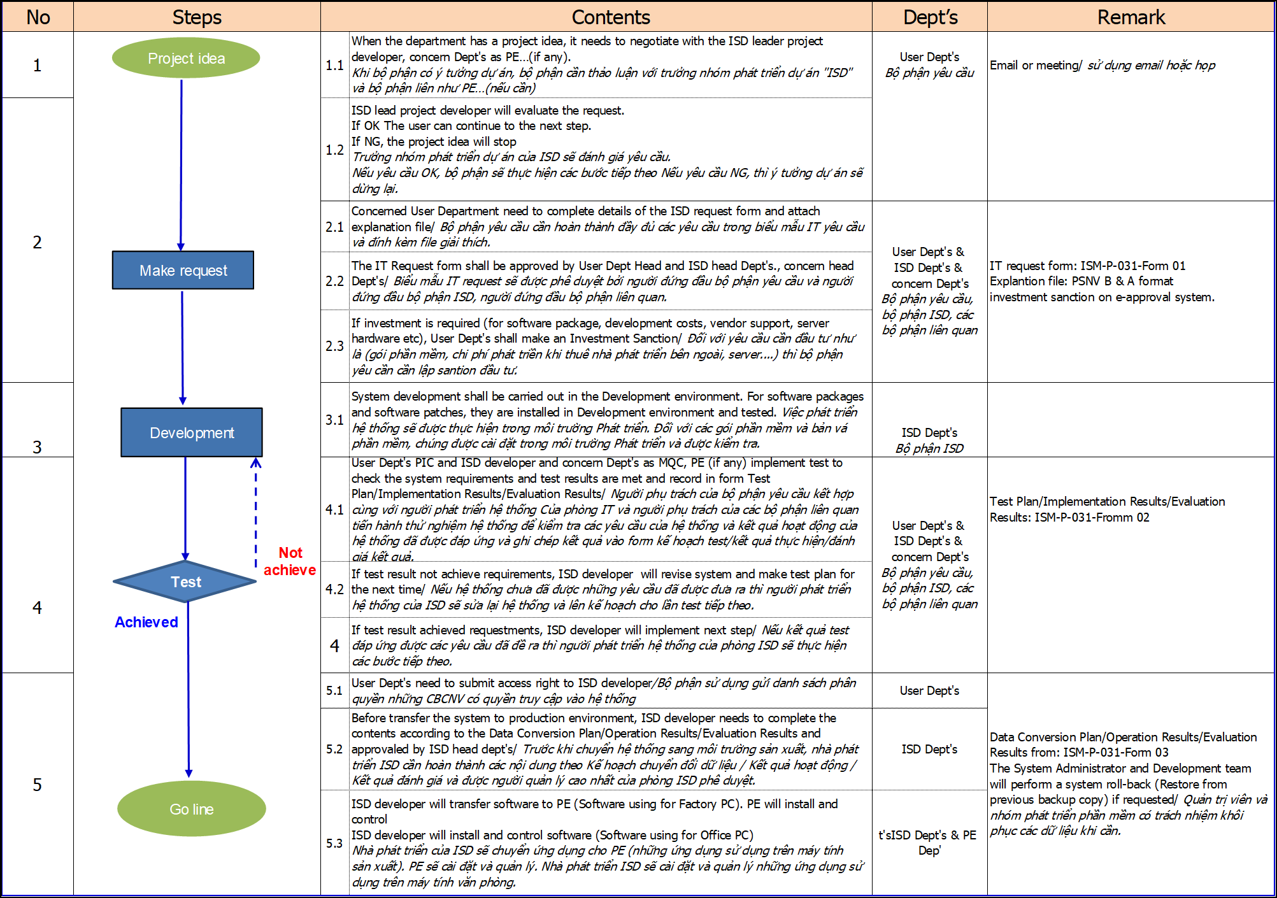
Visualize the System Development Project
5/5
Visualize the process, responsibilities, documents to System development project
Developer: Tran Thi Huong
Apply: Jun-2022
Expn: 0
Visualize the Process
◆Before
◆ After
Process
Contents, documents
Responsibilities
Not show overview flow
Unclear responsibility and document at step by step
➔ User will be difficult understand and follow.
Combine all in one ==> User easily understand and follow
Notes:
Last one, I introduce about: visualize system development project
On ISM document, system flow not clear step by step. (chỉ bút)
We change: add flow chart and content. (chỉ bút)
For easy understanding.
That all my report.
Thanks for listening

Slide 7
Thank You !

